Slide 1
CUSTOMER SALES REPORT
By muhammad Zain

Slide 2
Table of content
Effect of Packet Size in Customer Purchases and in Sales
Sales done by Customers belongs to different Life stage
Customers Buying rate at a Single time
A Negative Trend of Sales
Which Chips Brand have High Purchase By Customers
Brand Purchases by Life Stage of Customer
Customer Type and Total Sales With Chip Brand
Total Sales by Customer Life Stage and Chip Brand
Conclusion
Recommendation.

Slide 3
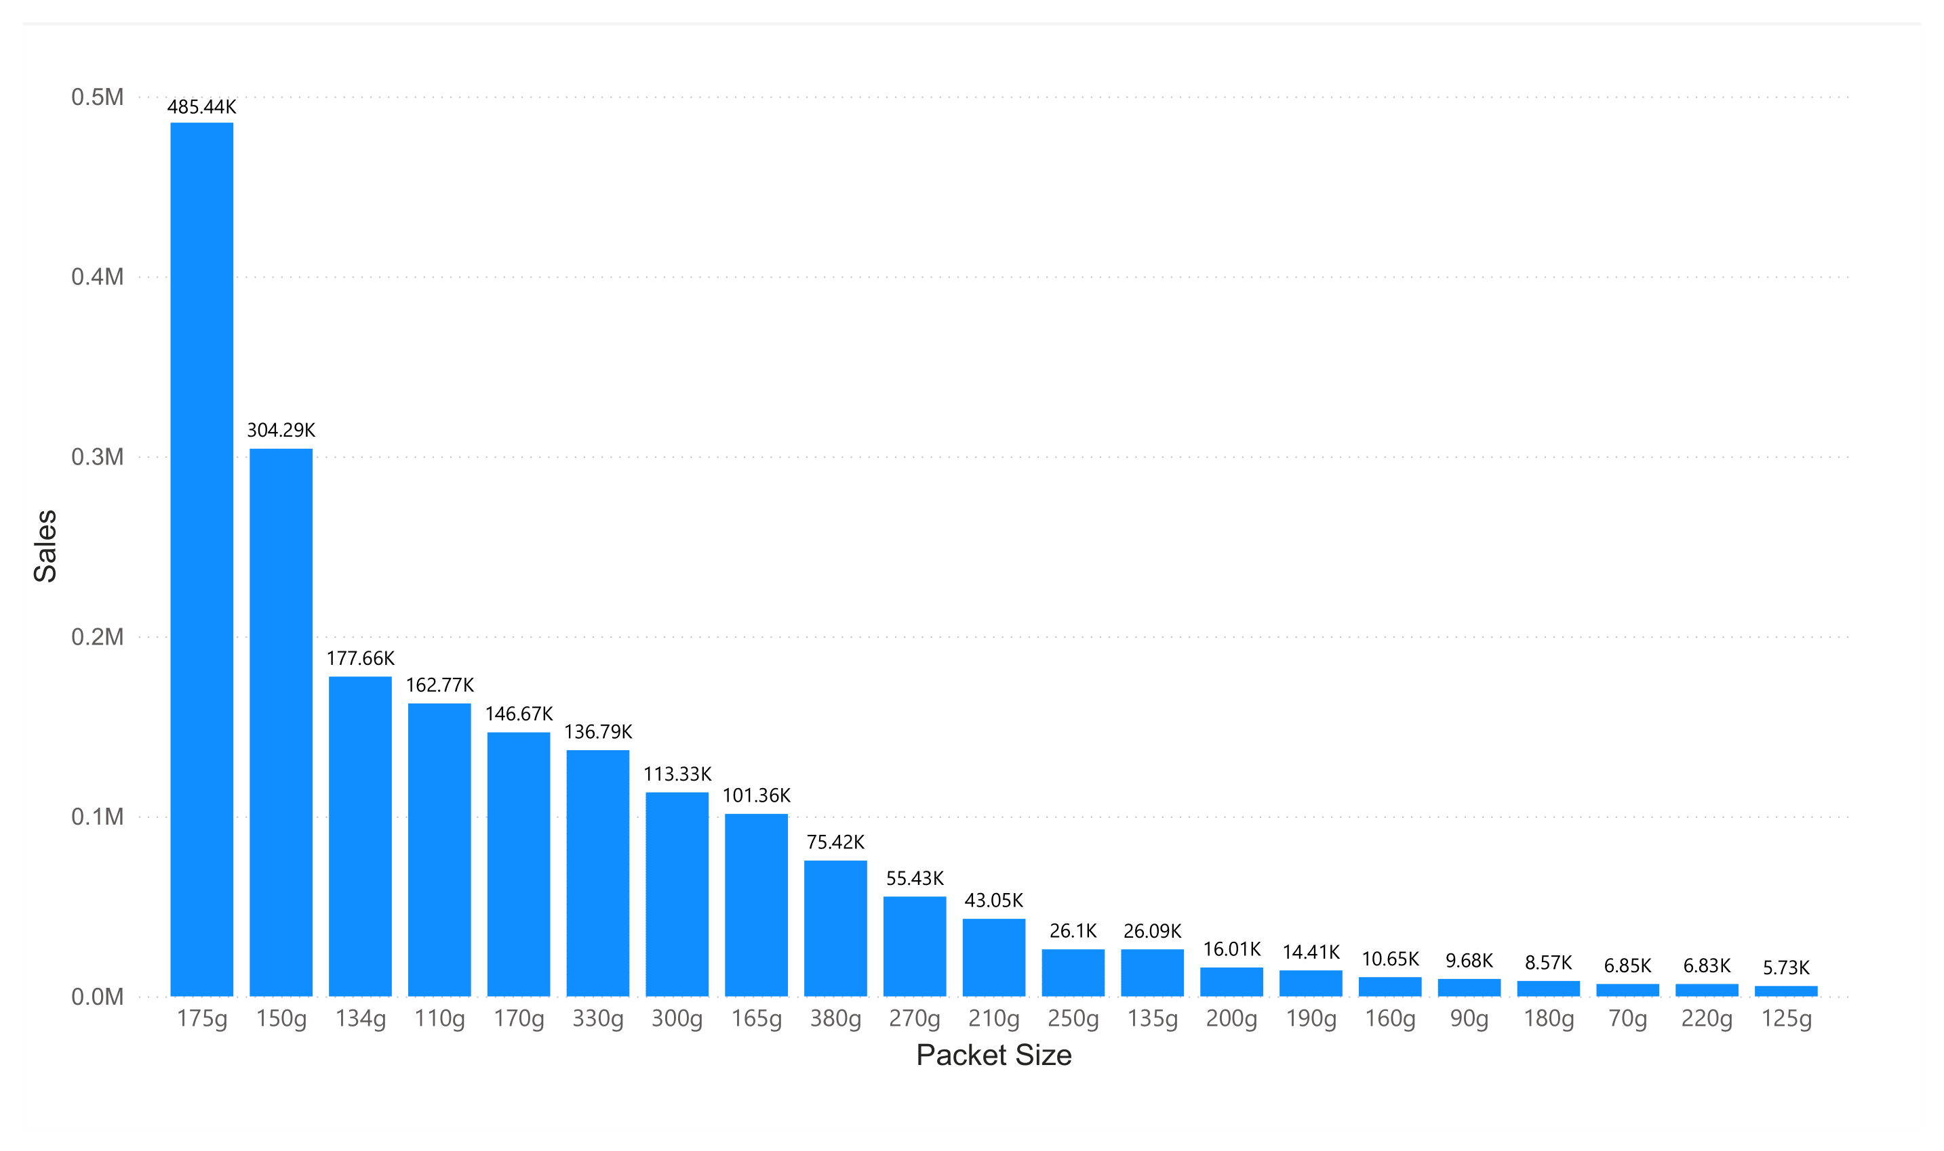
Effect of Packet Size in Customer Purchases and in Sales:-

Slide 4
In Previous Chart:
The Chart is Showing that the Sales According to Packet Size.
The Highest Selling Chips According to Packet Size (in grams) is 175g
Customers are most likely to buy, Big Packet Compared to Smalls Packet size chips
Here are some Top Sold Chips according to Packet Size (175g, 150g, 134g. 110g, 170g, 330g, 300g)
Here are some least sold chips according to Packet size are (125g, 220g, 70g, 180g, 90g, 160g)

Slide 5
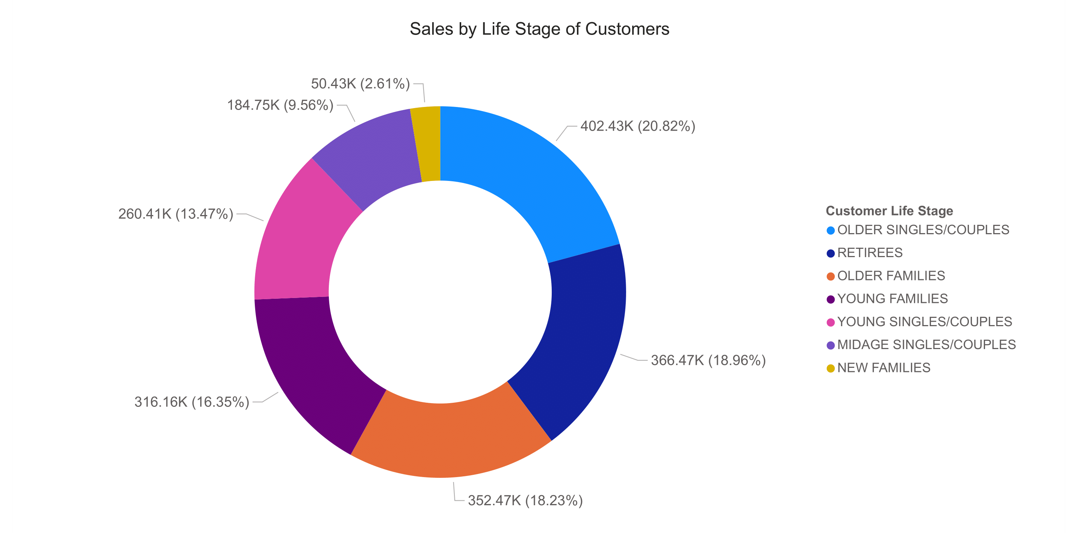
Sales done by Customers belongs to different Life stage:-

Slide 6
In Previous Chart:
The Chart is Showing About behavior of Customers in Different Life Stages.
According to This chart Our Customers is Mostly belong to high age group or senior citizen
Most buying customer group is Older Singles/Couples, Retirees, and Older Families
This Chart also Shows that the Younger Peoples includes (Children, and Adults) May have consume different category of food other than chips like fast foods.
According to This Graph. We should take a decision to grab attension of younger ones, by doing to different packaging , or by marketing campaign etc.

Slide 7
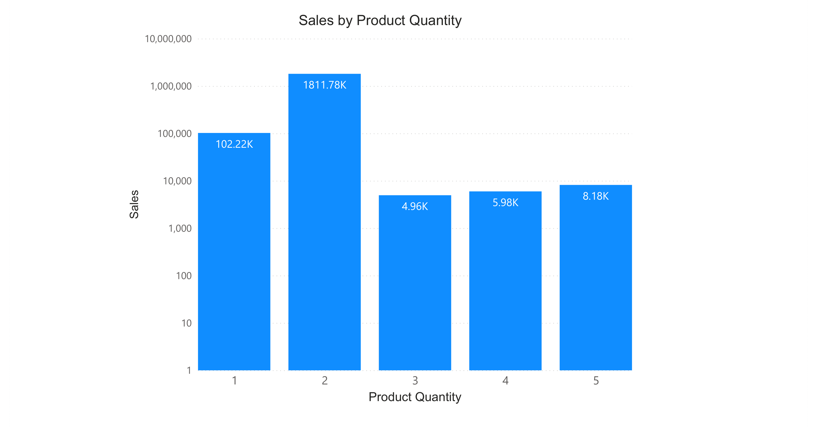
Customers Buying rate at a Single time:

Slide 8
In Previous Chart:
The Chart is showing that Customer behavior of buying how much number of chips number Chips at a single
Sales Generated by Buying 2 packets at a single time, Is Extremely High as compared to other, which conclude that the trend of buying Number of packet of chips is 2.

Slide 9
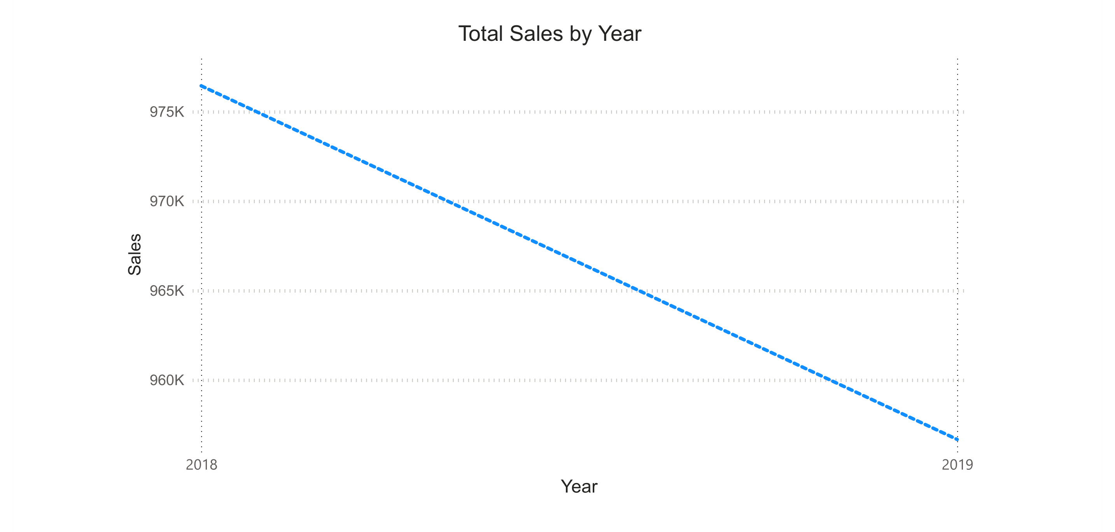
A Negative Trend of Sales

Slide 10
In Previous Chart:
The Chart is representing a Trend or a Negative Trend of Sales from 2018 to 2019.
According to the Data:
Sales in 2018 is 975K
Sales in 2019 is 956K
There is 2% Decline Sale from 2018 to 2019
This is Decline is done by overall decline, example lose of customer, less purchasing of customer, etc

Slide 11
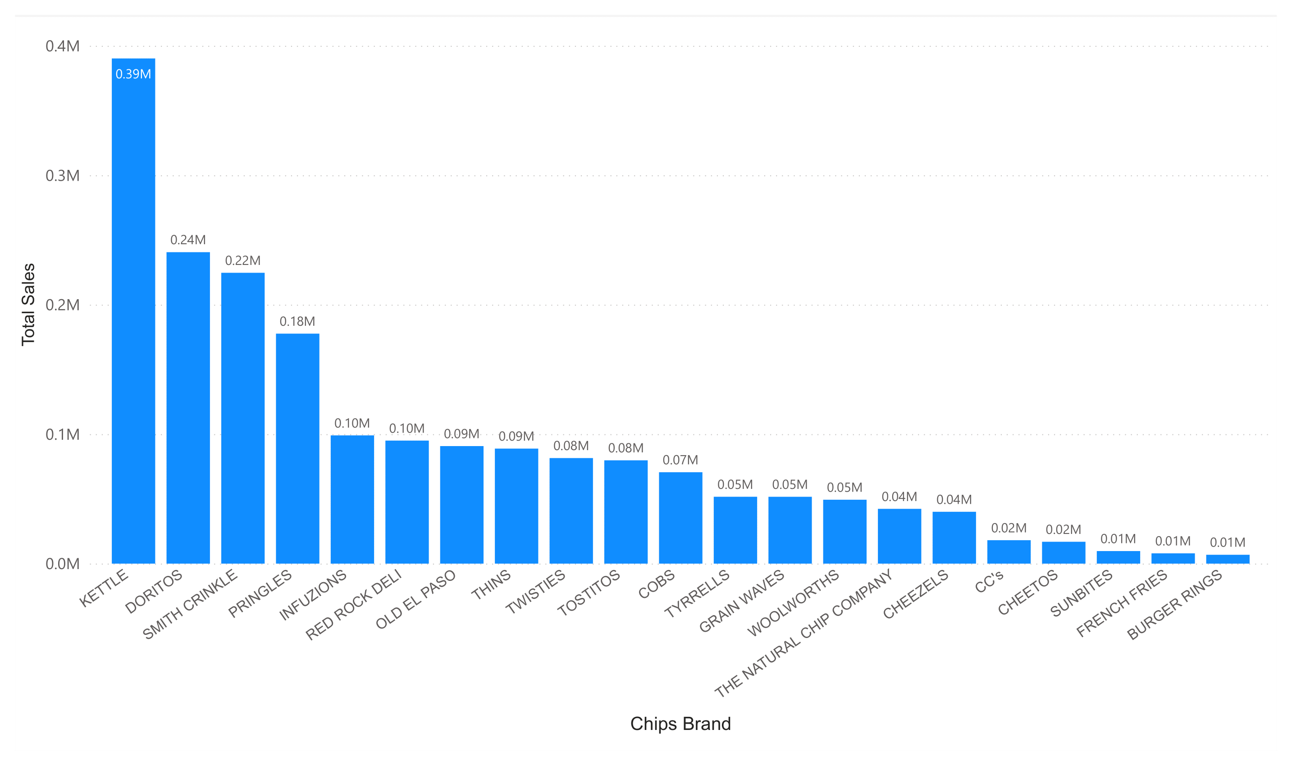
Which Chips Brand have High Purchase By Customers

Slide 12
In Previous Chart:
The Chart showing insights of Brand to Sales and Behavior of Customer Purchasing
According to the Data, KETTTE Brand is Generating More Sales Along Customers.
Top 3 Best Chip Market Performers.
KETTLE – 390K
DORITOS – 240K
SMITH CRINKLE – 220K
The least Customer Purchase Chip brand is BURGUR RINGS.

Slide 13
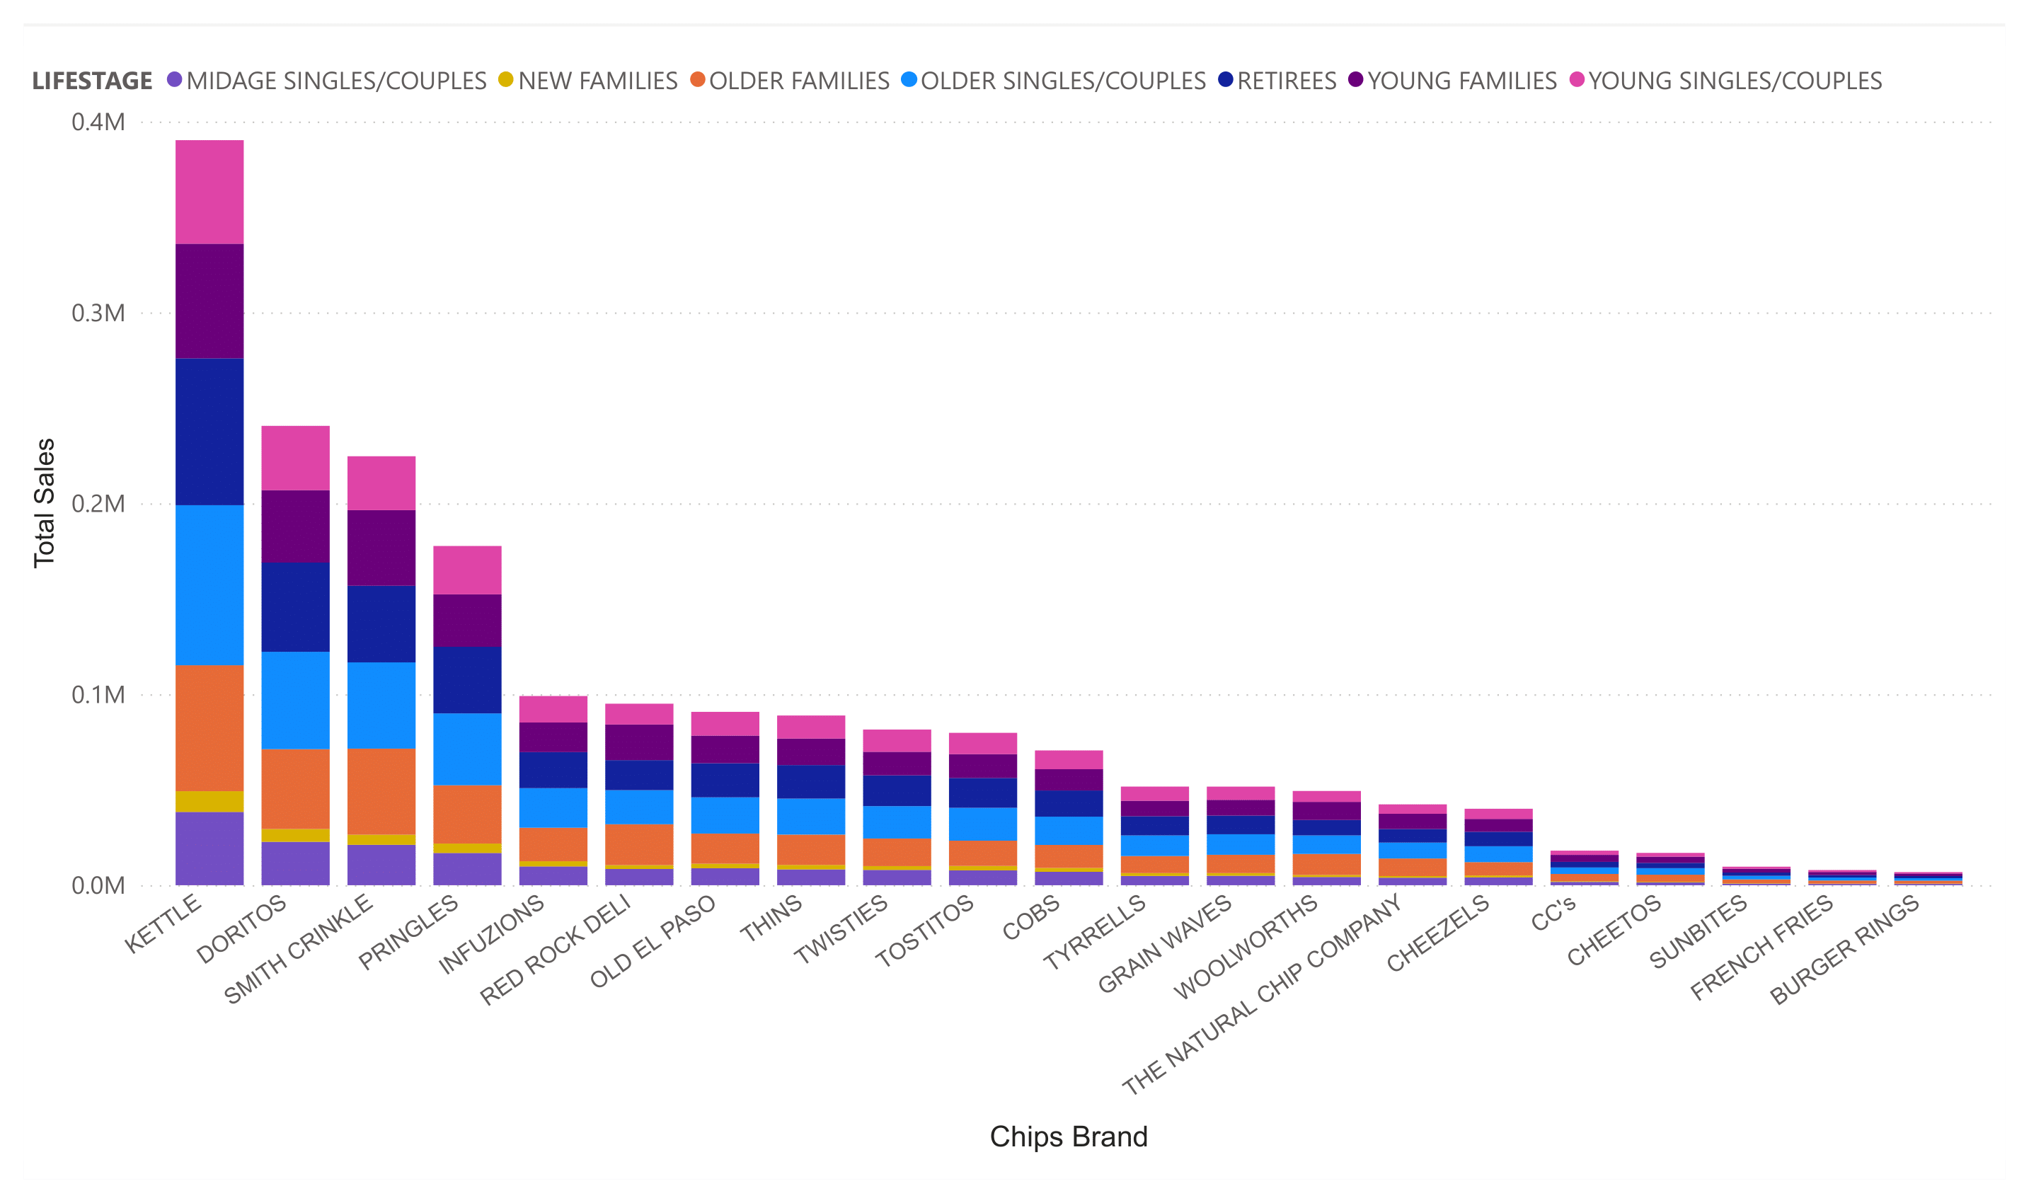
Brand Purchases by Life Stage of Customer

Slide 14
In Previous Chart:
The Chart showing insights of Brand to Sales and Behavior of Customer Purchasing With the Life Stage of Customers
As Mentioned early that, KETTTE Brand is Generating More Sales Along Customers. But if talk about the estimate of Which kind of customer buying more chips, are senior citizen, Older Families.
The Particular Pattern is followed in every brand purchases is that, New Families are buying very less chips.

Slide 15
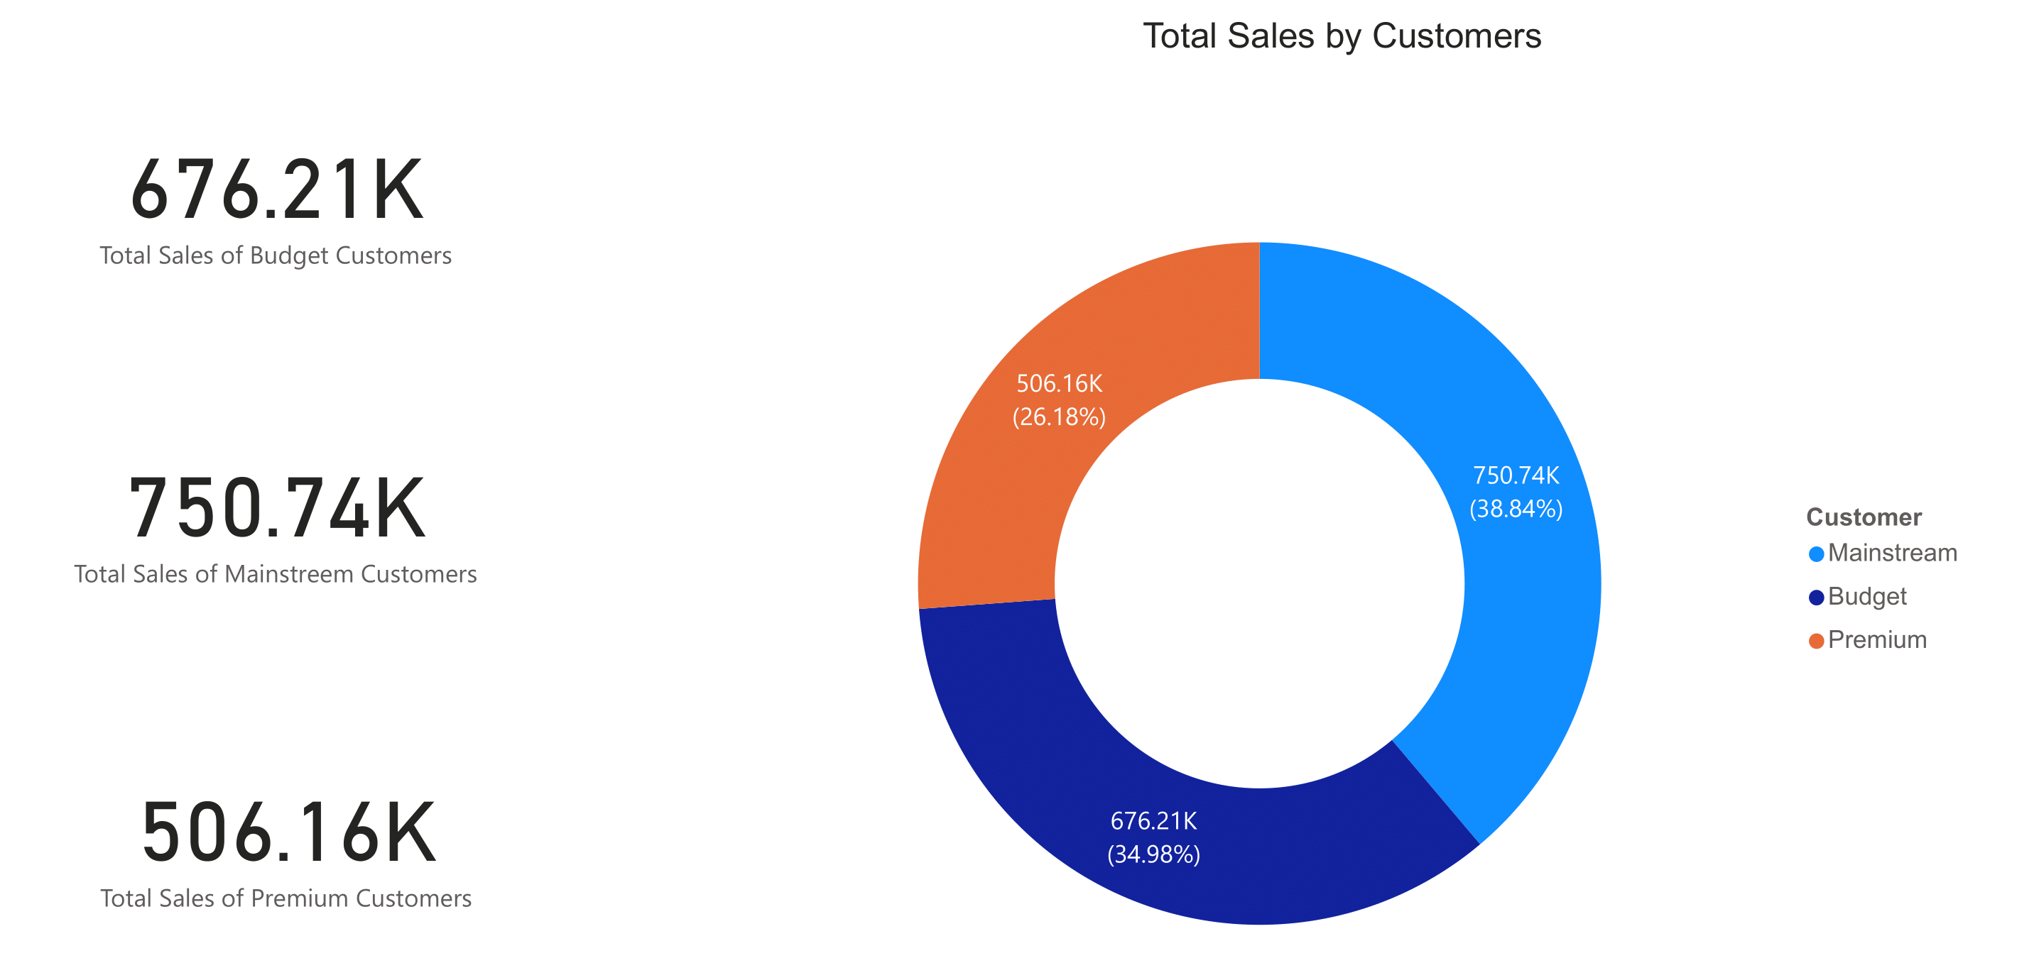
Customer Type and Total Sales With Chip Brand

Slide 16
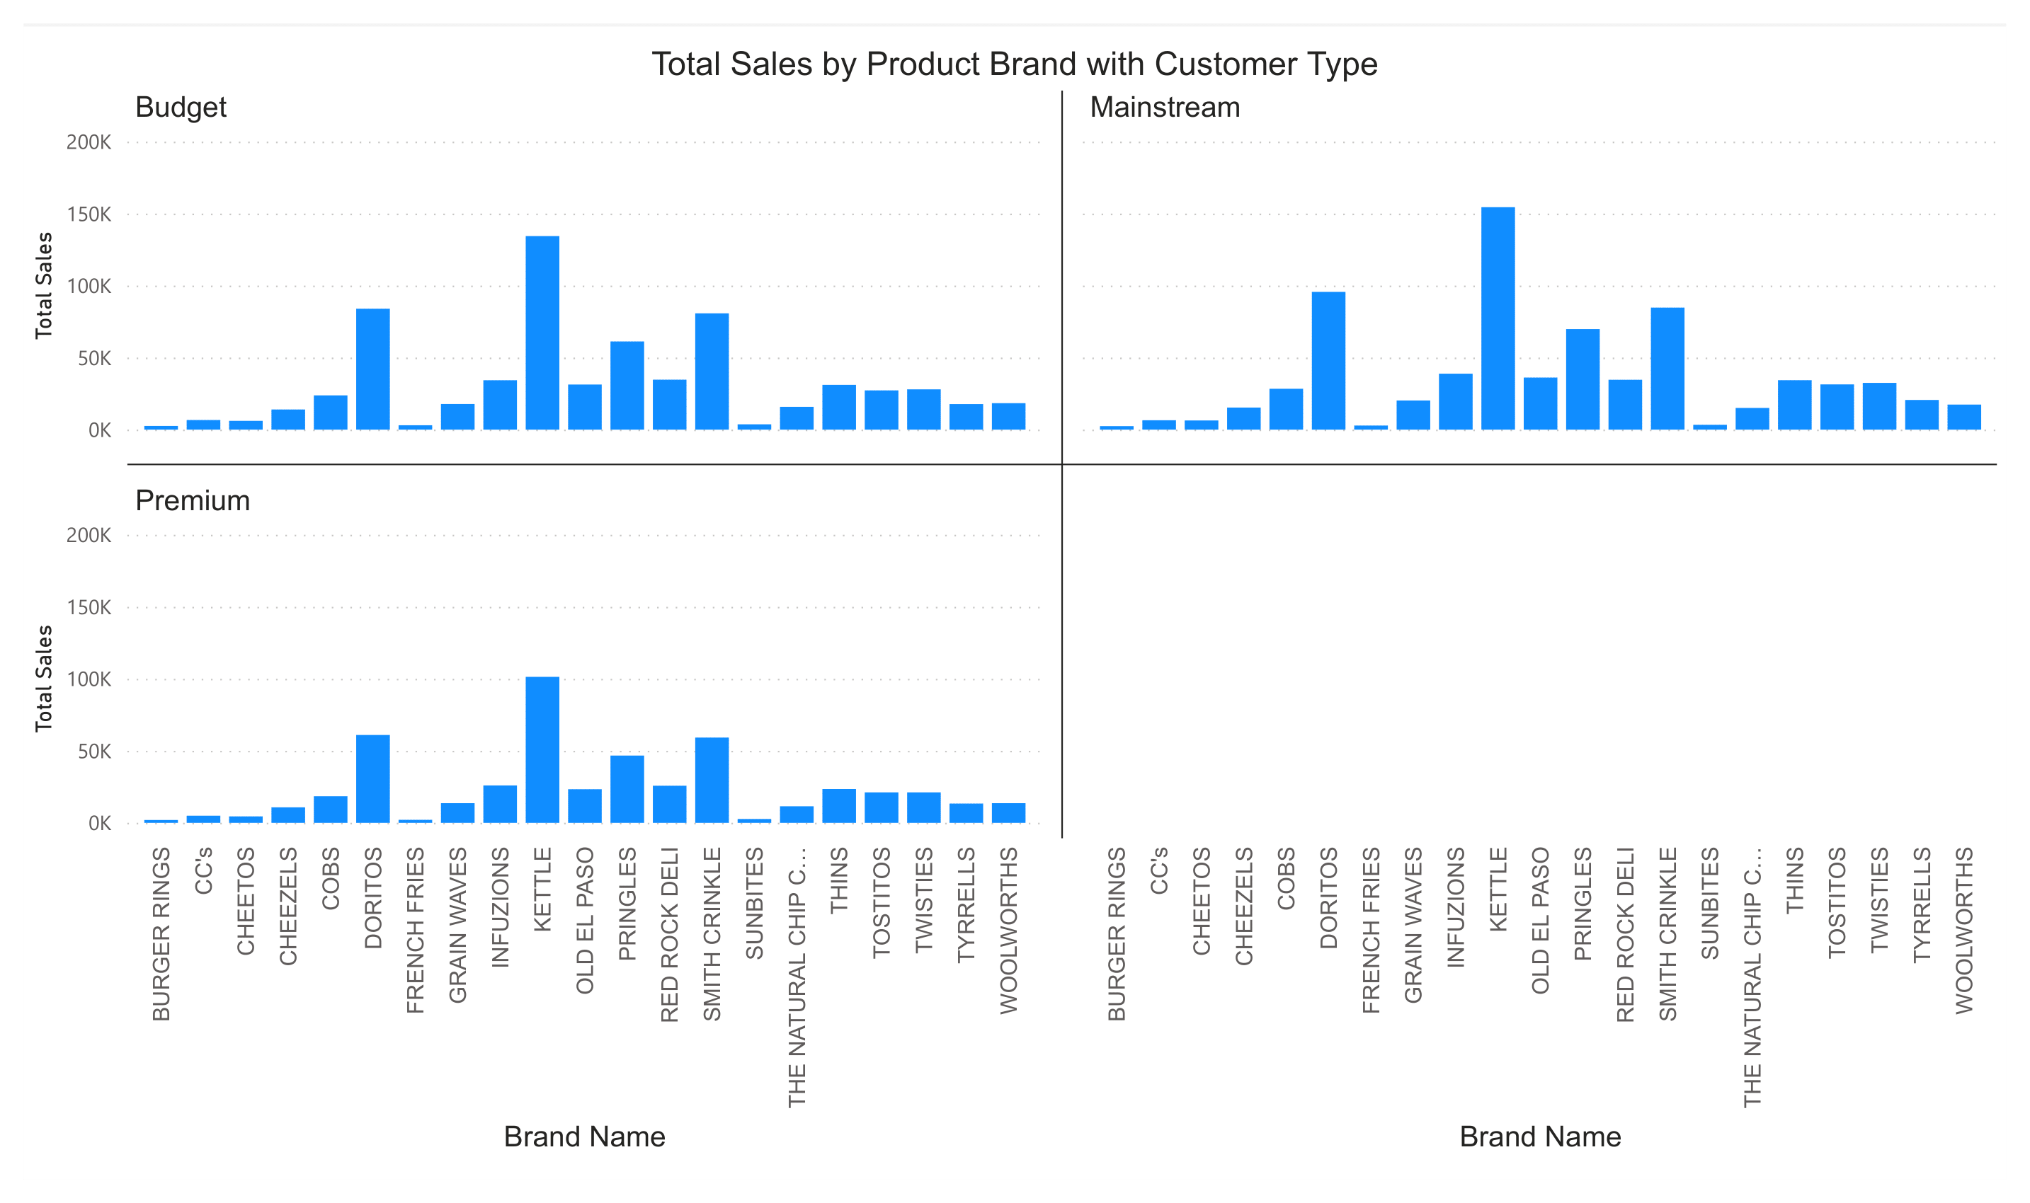

Slide 17
In Previous Chart:
The Chart showing insights of Total Sales, and which types of Customer buying which brand.
According to the data, our mainstream customers, are buying more, and I previous showed data KETTLE BRAND is Standout on 1st in overall Sales.
Our Premium Customer buying less as compared to mainstream and budget customers.

Slide 18
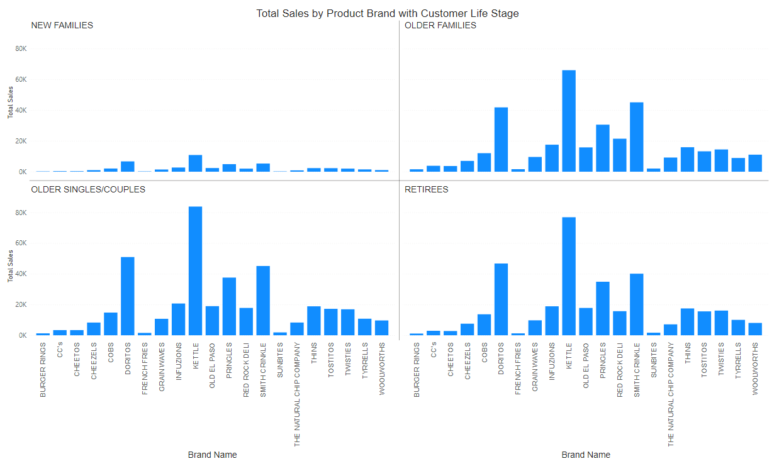
Total Sales by Customer Life Stage and Chip Brand

Slide 19
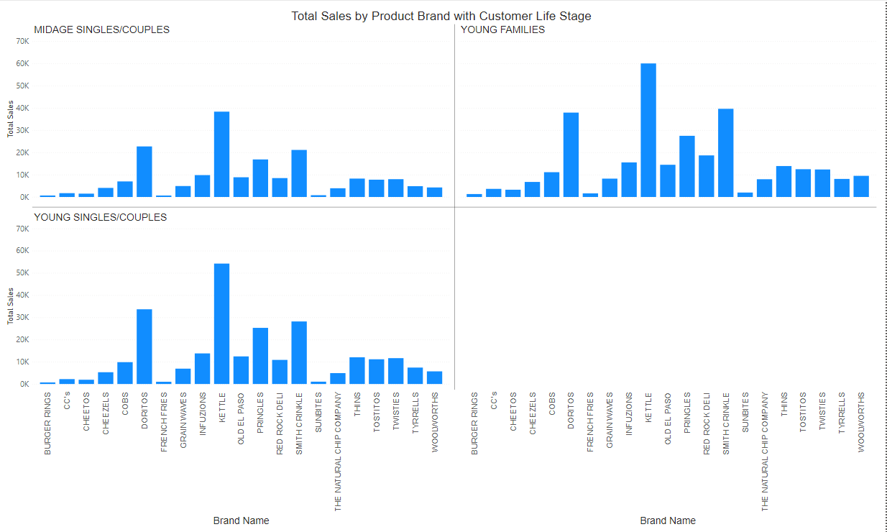

Slide 20
In Previous Chart:
The Chart showing insights of Total Sales, and Different Life Stage of Customer buying which brand.
As we talk earlier, Senior Citizen, Retirees, Old Families created more sales than, Younger ones and new families, In this chart we can clearly see that,
This data Also proves that KETTLE Chip Brand is Doing well.

Slide 21
Conclusion:-
After Deep Analysis of Data, and Customer Behavior of Purchasing trend, here is conclusion
Our Most Sales Generating Customers Are: Mainstream and Older Customer.
Customer another behavior while Purchasing chips, they buy a couple of 2 chip packets, Approx 93% of Our Customer by 2 Packet of Chip in a single Purchase.

Slide 22
My Recommendation :-
After Analysis data, I have seen that Sales are generated by Old Customer and Younger are buying, and May be this is the reason that our sales are declining from 2018 to 2019, My recommendation is do some campaign for young audience, grab their attention, and there will be a positive change in Sales.
And Another thing is that, Our Premium customers are buying very less as Compared to budget and Mainstream customers, so we should make some vouchers or discount cards for our premium customer, so we get their attention back.
Due to declining Sales from 2018 to 2019, we can make an offer buy 1 get 1 free and something similar to that. That will positively effect on sales.

